Slide 1
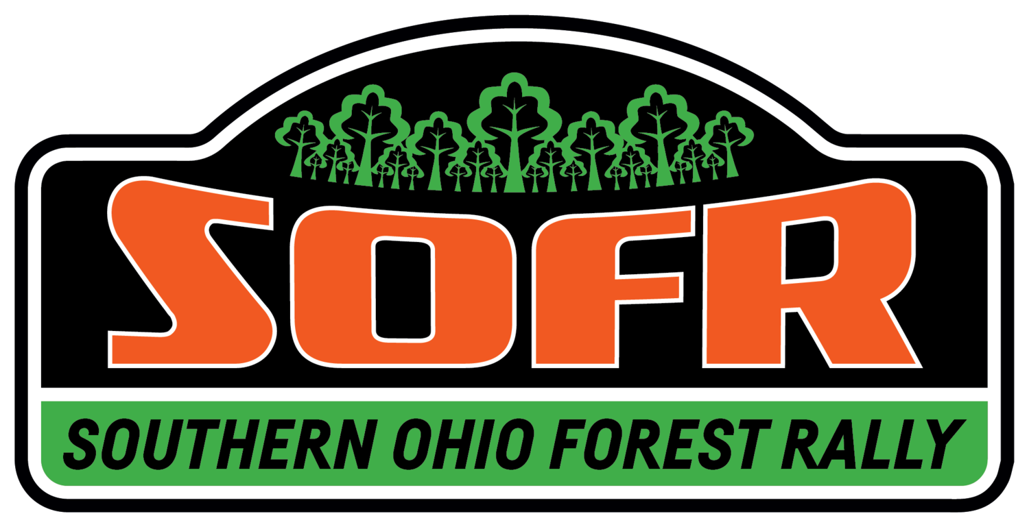
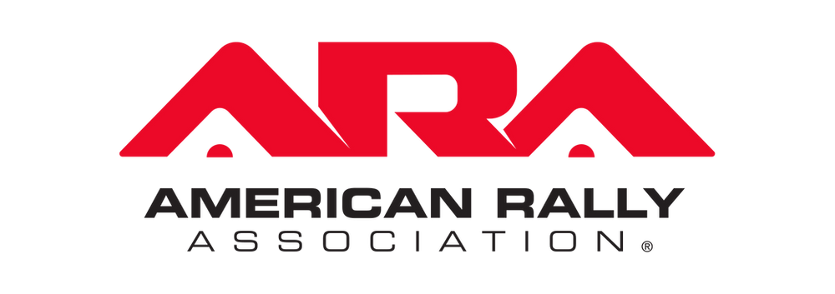
Keeping it Shiny Side Up: A Qualitative Study of American Stage Rally
Nyvani Molina
Elizabethtown College
Landmark Summer Research Conference
Thursday, July 21, 2022

Slide 2
Introduction
What is American stage rally? Real Cars. Real Roads.
Niche and relatively unknown form of motorsport in the United States (but widely known globally)
Low visibility due to geography and limited funding opportunities
Limited degree of stability within the sport and less centralized governing structure
Key part of an ongoing 3+ year-long research project (student and faculty teams across multiple institutions)
Current research question

Slide 3
Brief Literature Review
Evans (2022)
Gardner and Phillip (1987)
Edwards and Corte (2010)

Slide 4
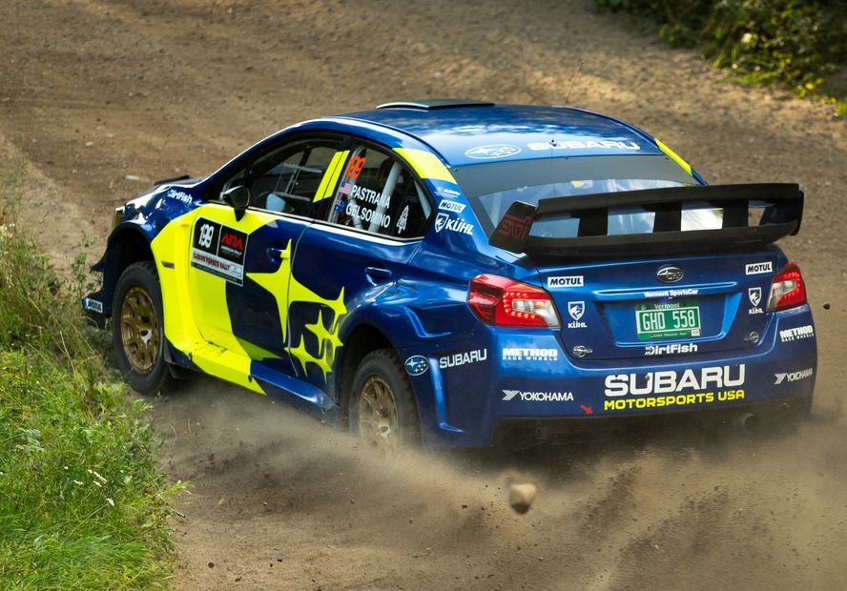
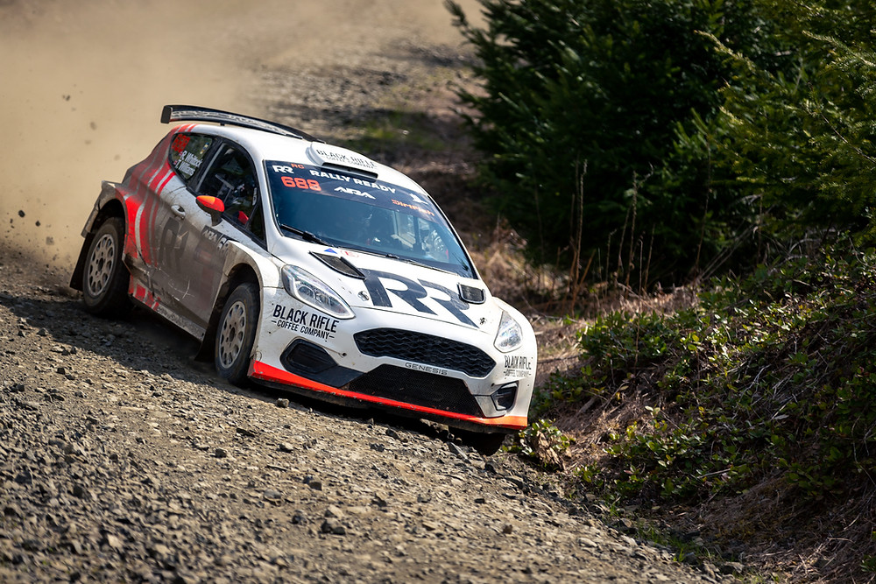
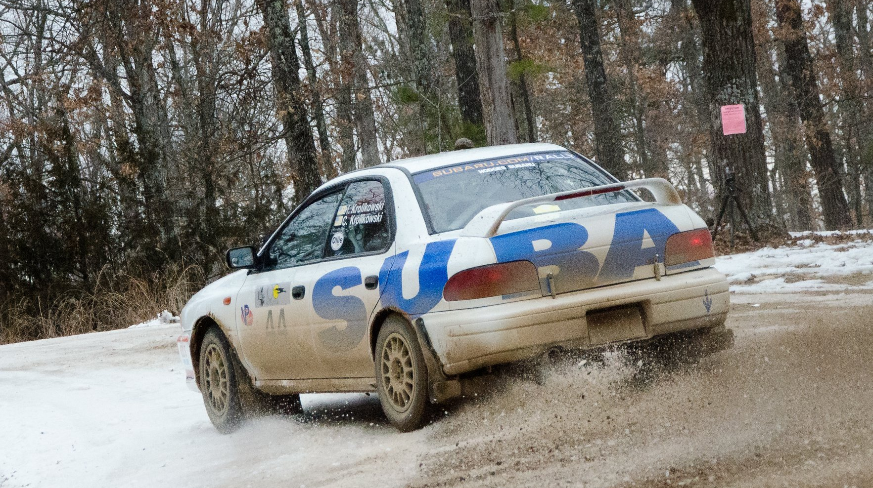
American stage rally
American Rally Association sponsors 9 national events a year across the U.S.
10 Regional and super regional events
What is a stage?
Competitive motorsport involving a race against a clock; trackless
Driver: typically the owner and operator of vehicle
Co-Driver: pace notes, and announcements, the guide to the stage, often referred to as a navigator
Crew: companions of the Team, Possible Mechanical Training

Slide 5
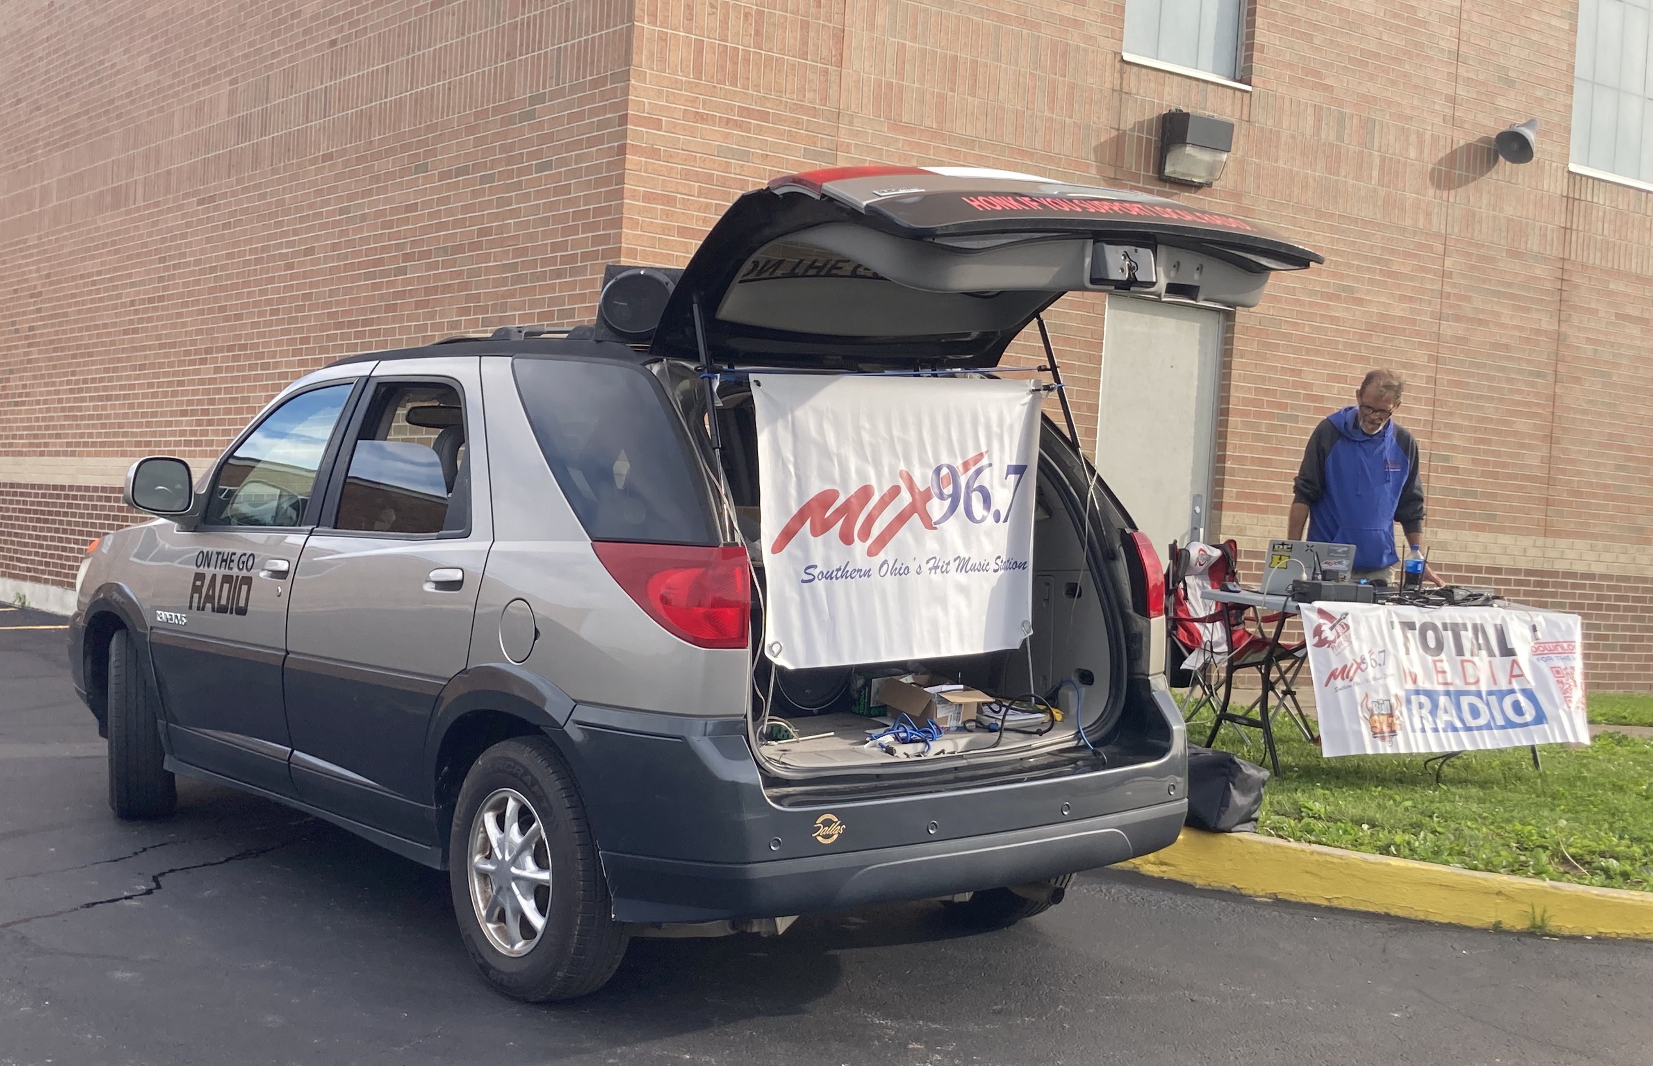
Commercialization in American STAGE rally
Unique Lack of Commercialization
Several companies brought to forefront of commercializing rally
Dirtfish: A primary rally news source
Factory teams (Subaru Motorsports/Vermont Sportscar)
Rally building and renting services

Slide 6
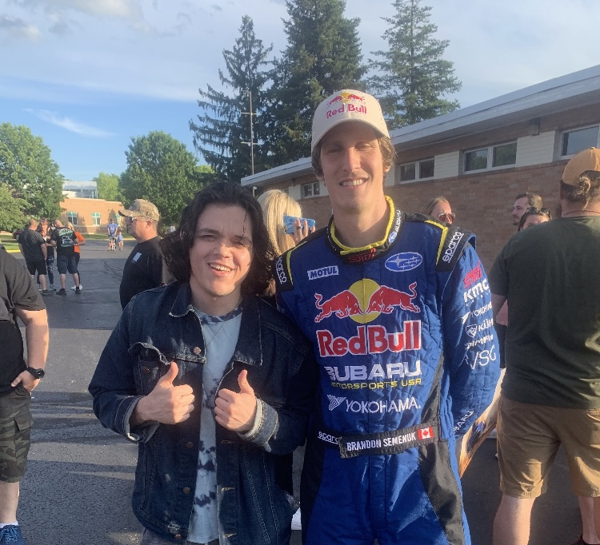
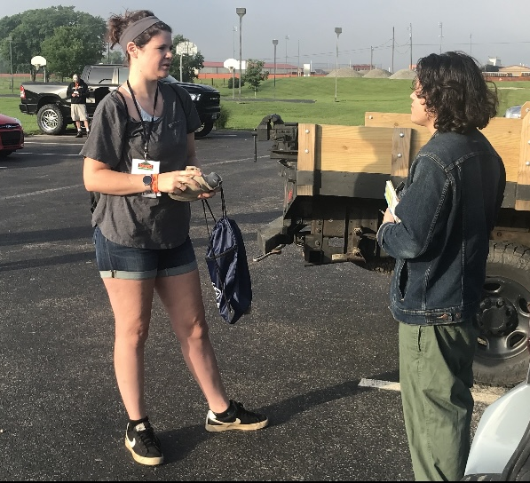
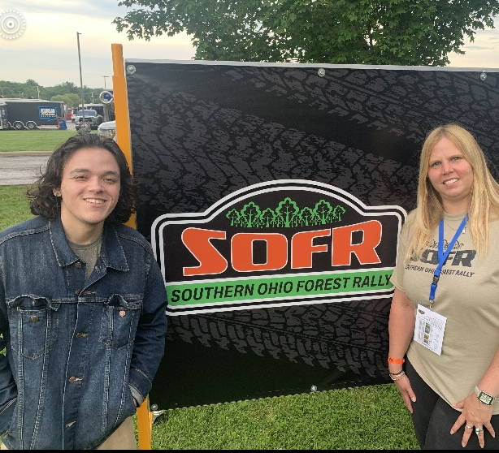
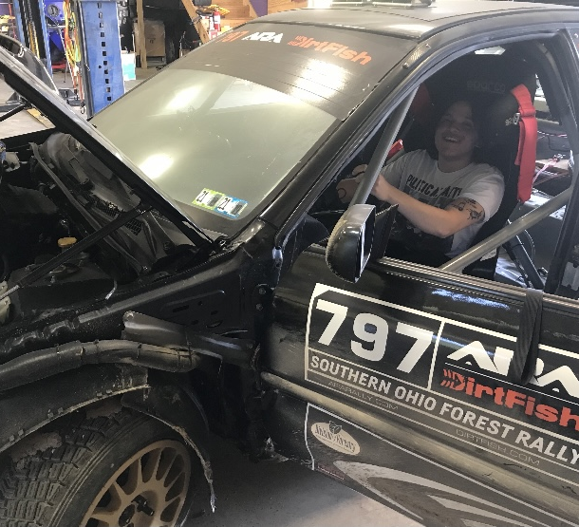
Methods of Data collection
IRB approval (exempt status) was obtained prior to the beginning of the summer research in May
Time spent learning the culture by watching video footage of American Stage Rally and listening to podcasts
Approximately 15 completed in-depth and on the spot interviews in both face-to-face and Zoom formats
Over 30 hours of participant observation at SOFR (June 9-12) volunteering at time control finish as well as a ride along in the sweep and start cars of stages
Content analysis of the North American Rally Facebook page posts

Slide 7
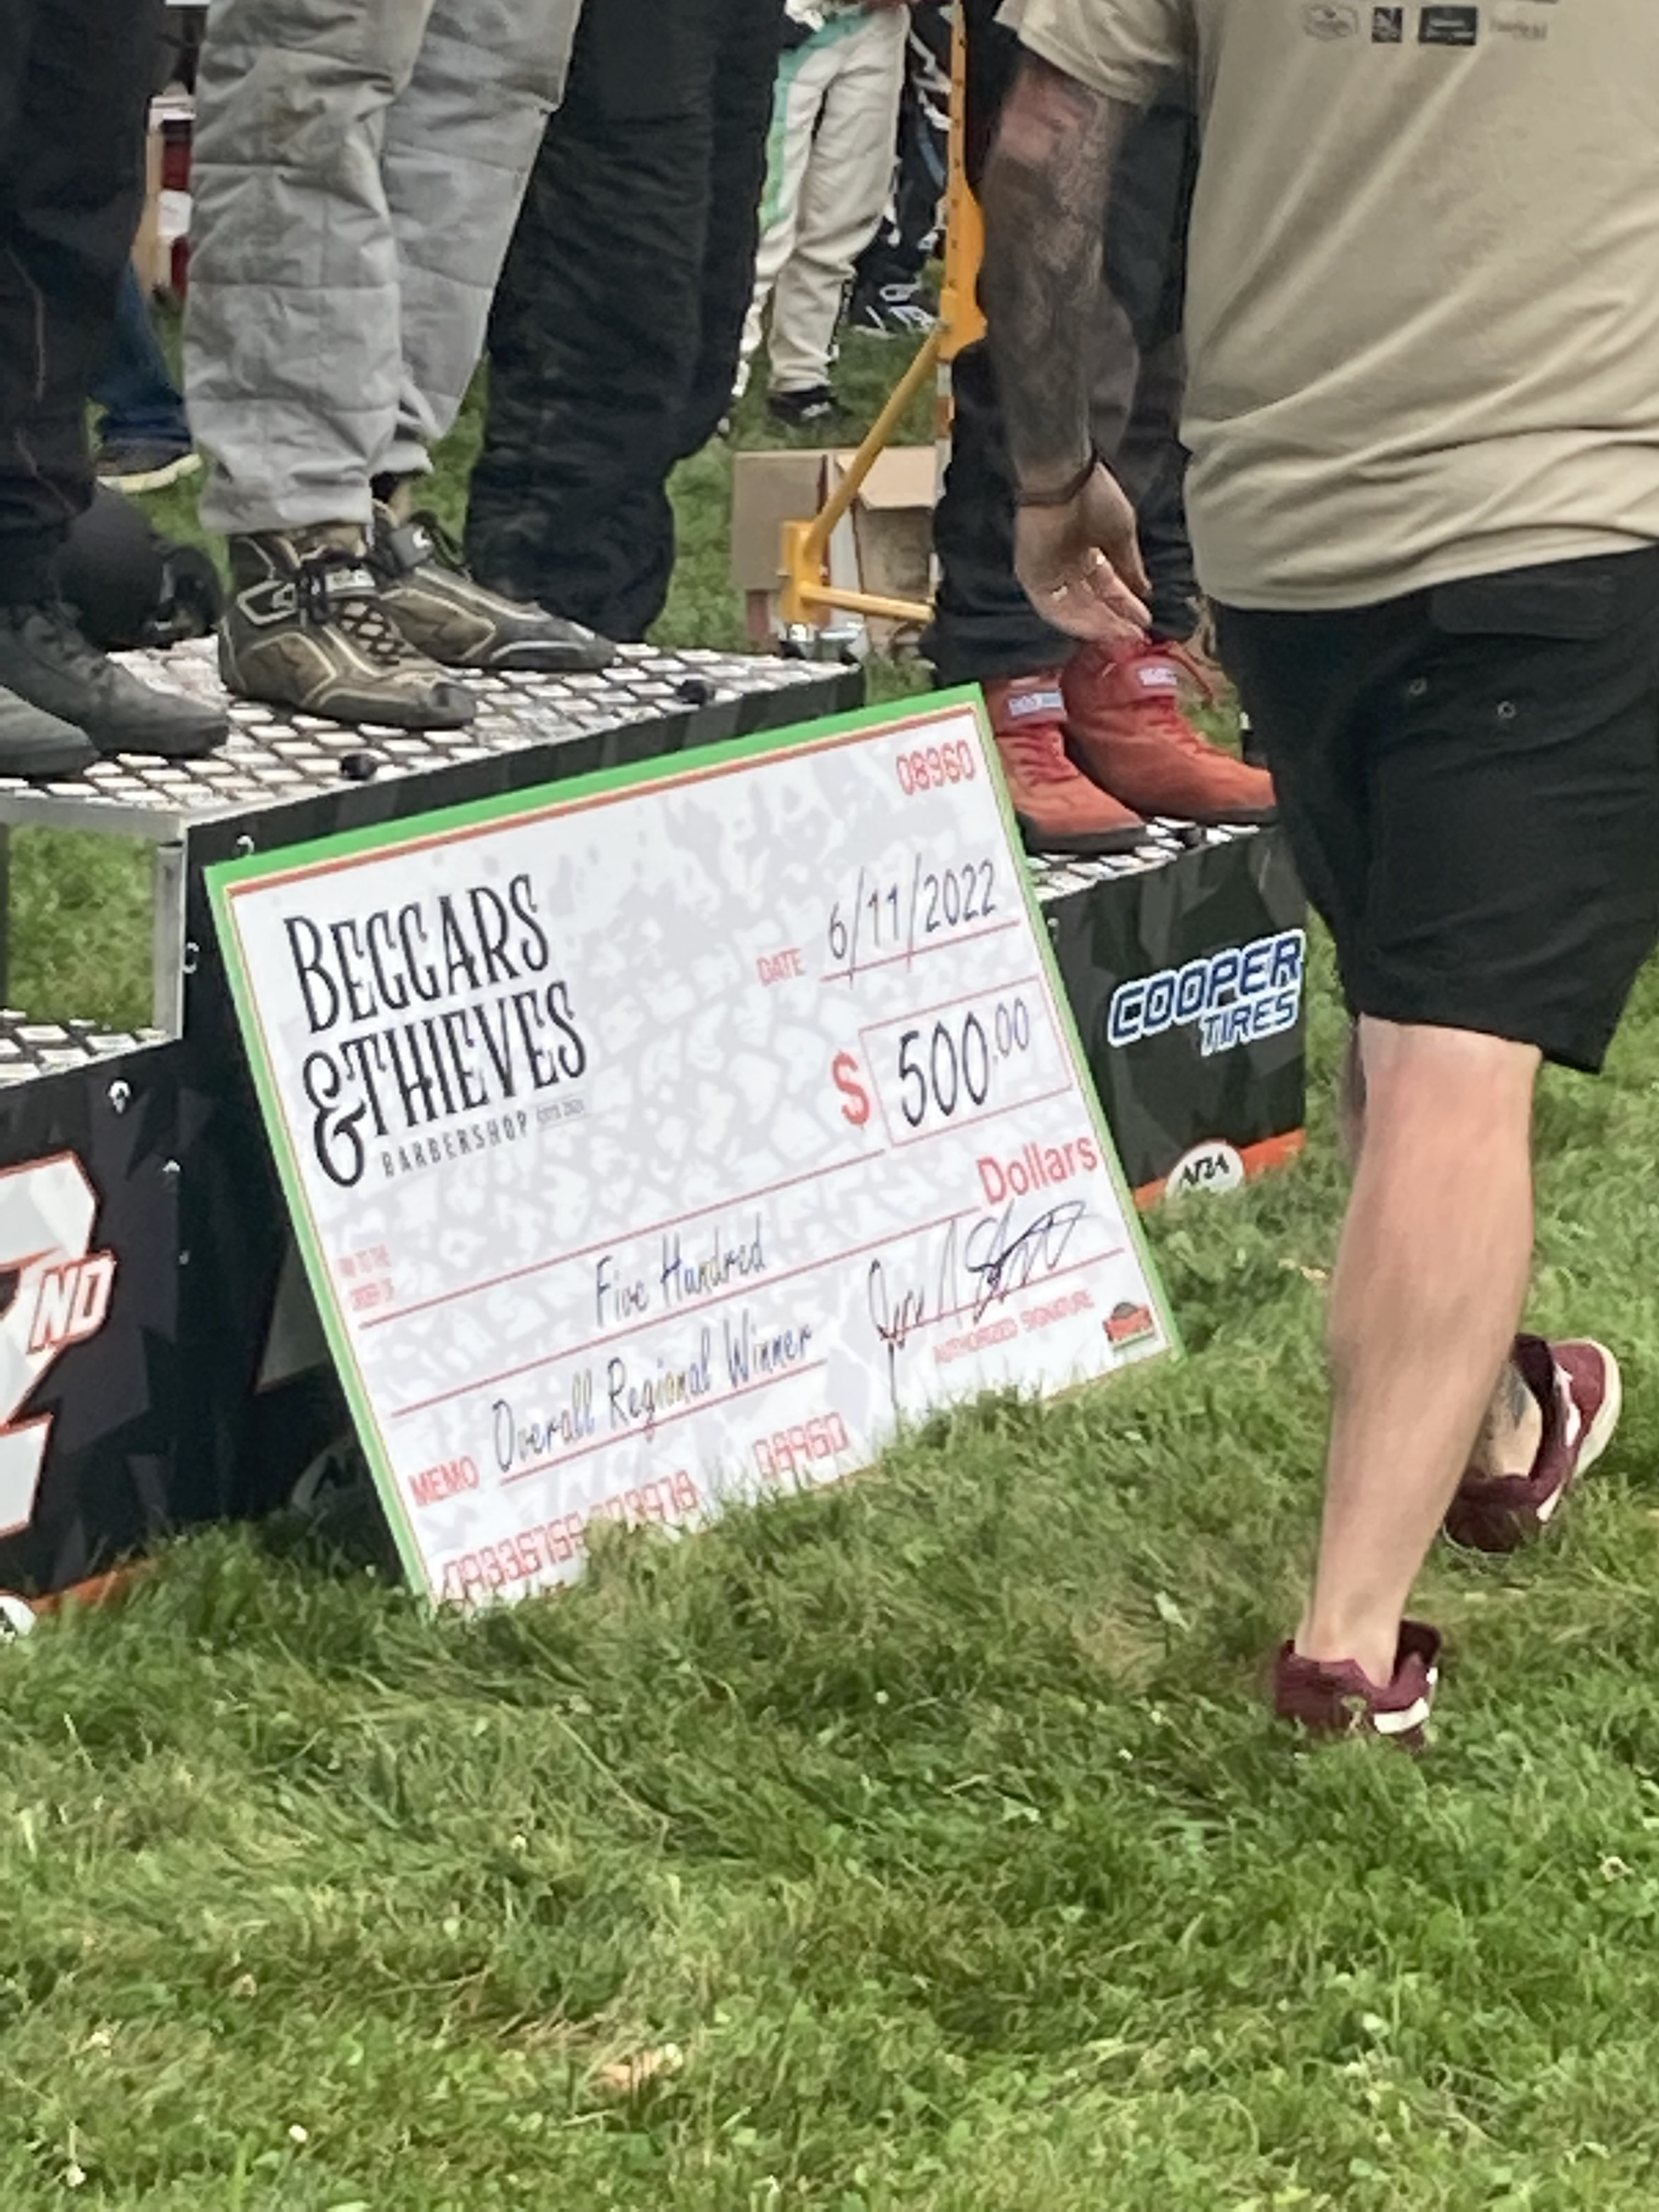
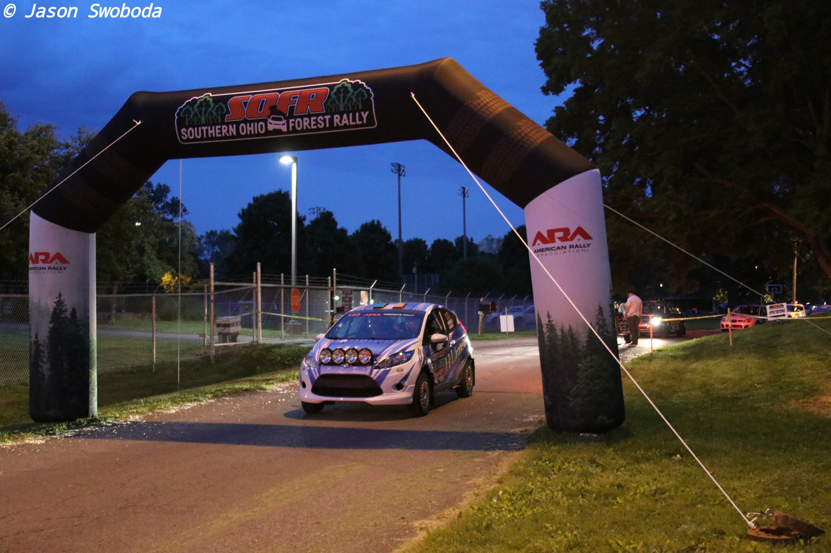
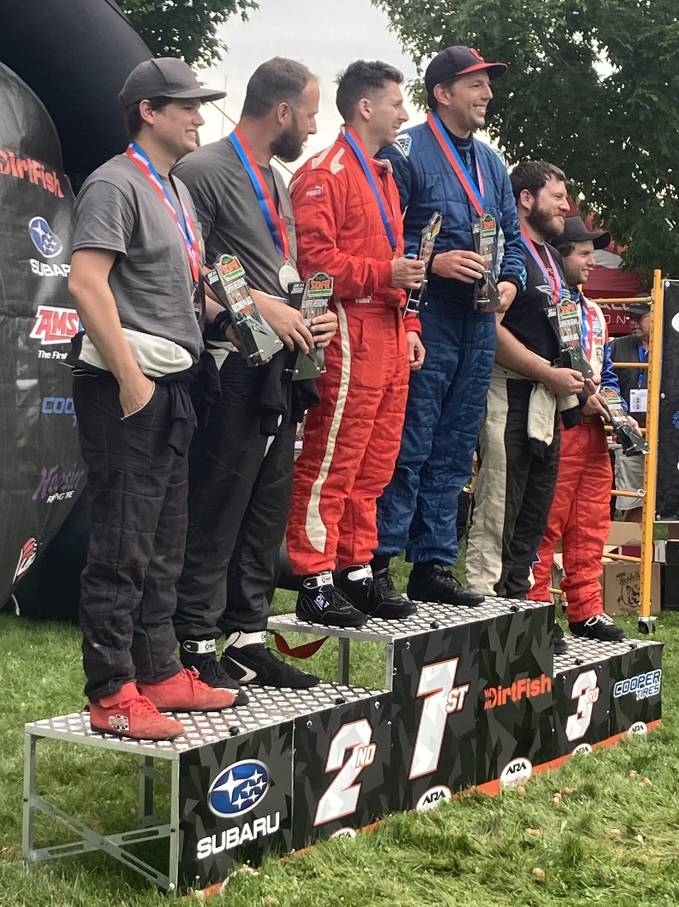
Southern Ohio forest rally(SOFR)
ARA National Rally Central Event
Racing in Southern Ohio since 1973; SOFR started in 2017
Located in Chillicothe, Ohio and surrounding forests
Sponsored by Wagner Subaru (Dealership) and others
Known for the historical roads and infamous City Park stage
5th leg of the ARA National Championship
3-day event
82 competitor entrees at start; 49 total cars finished
Several “Factory Teams”
Example of Incentivization
“Rallying does cost money and although we've searched the Ohio Forests we have yet to find a money tree.”

Slide 8
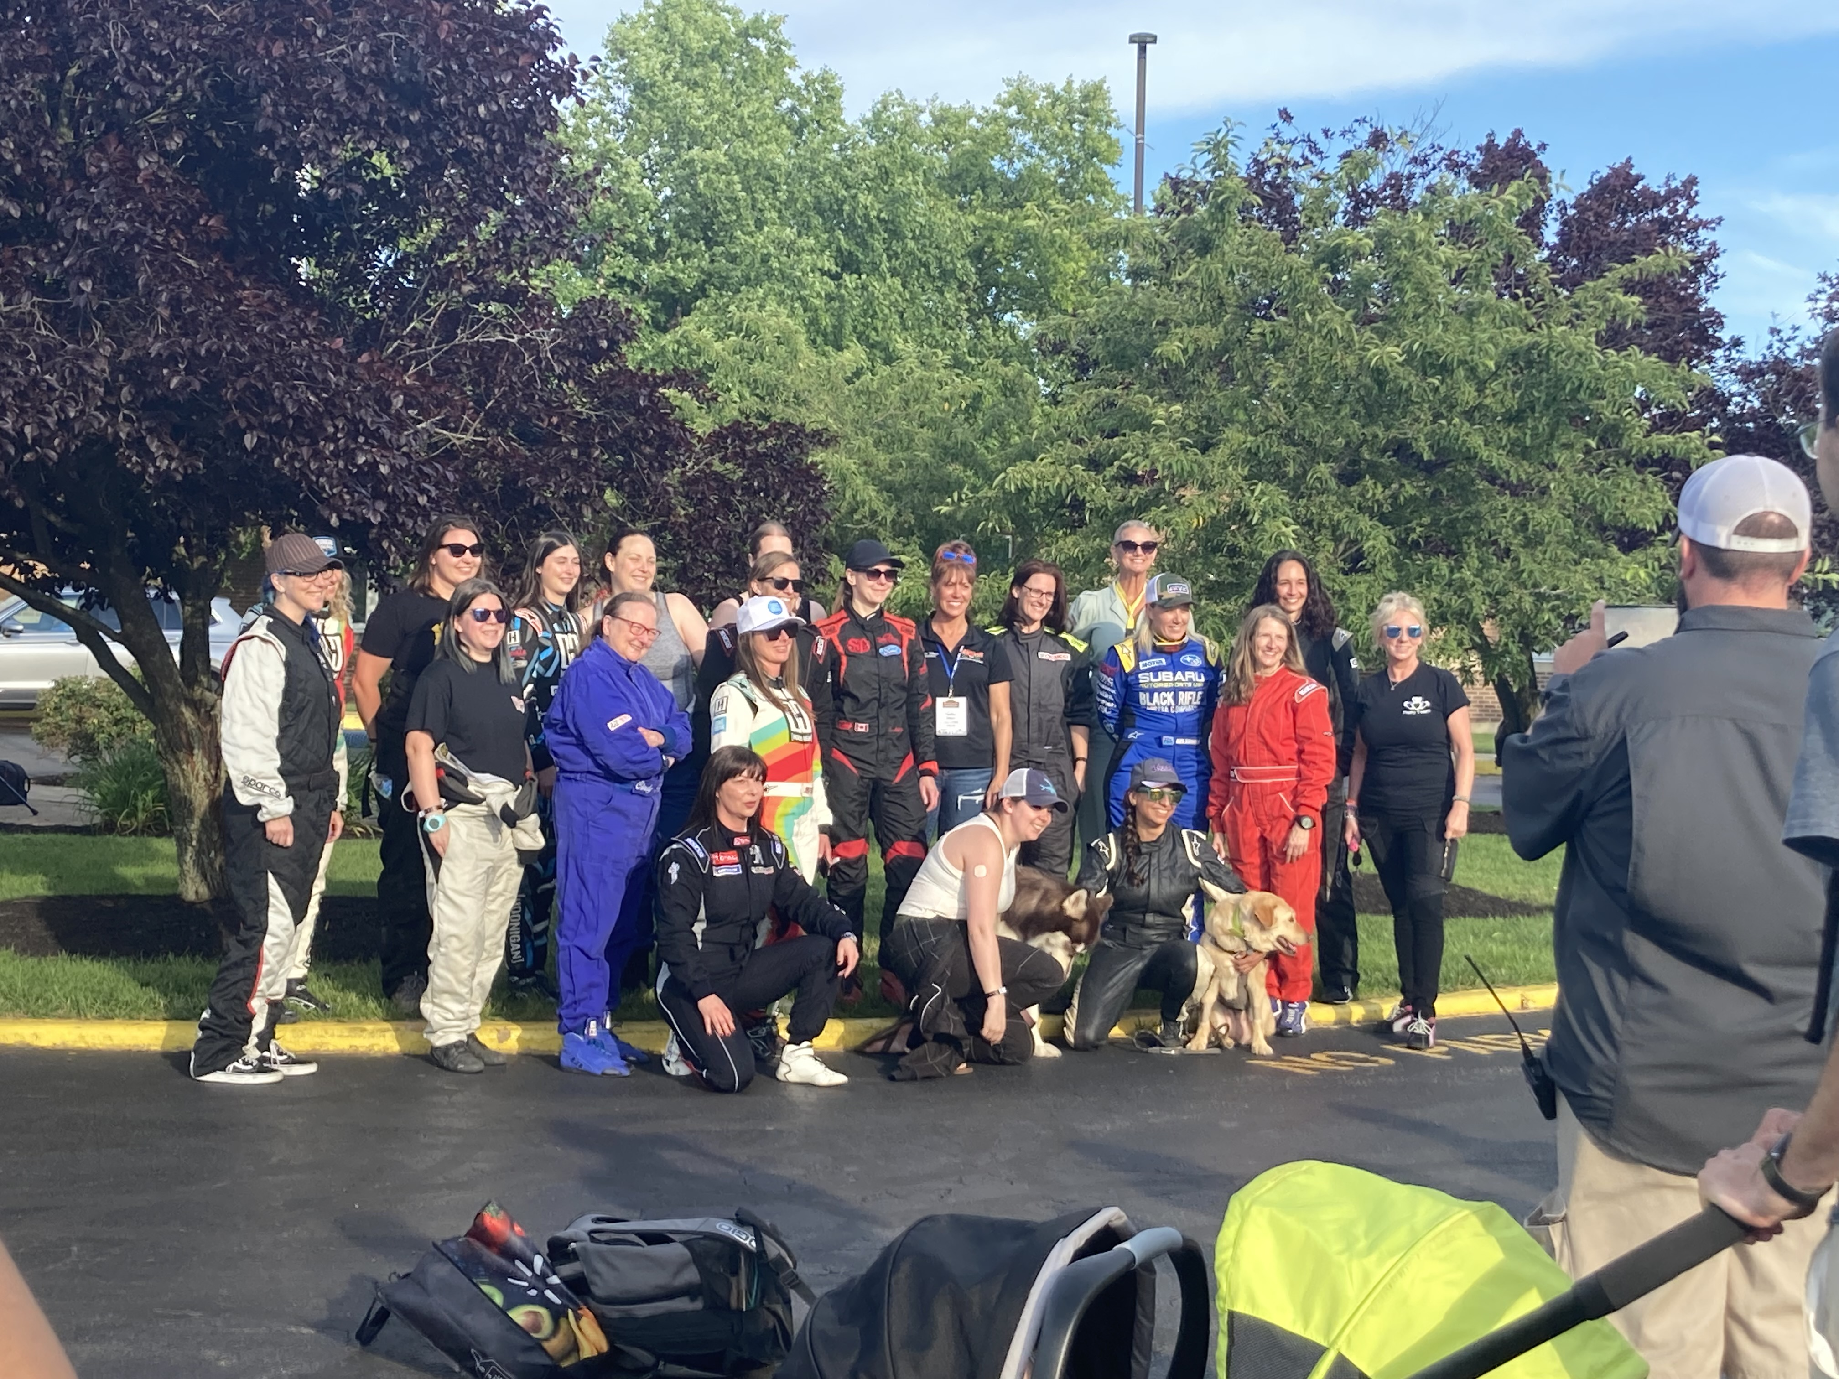
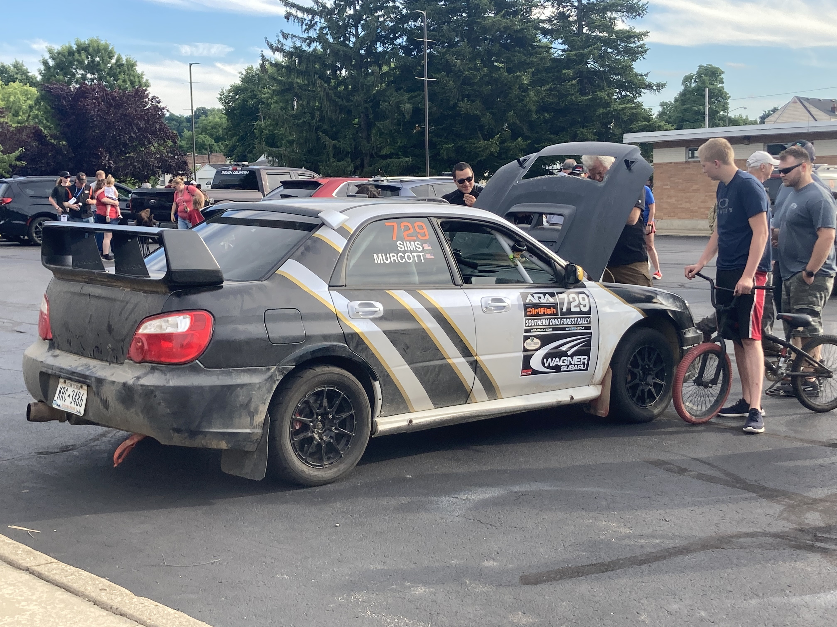
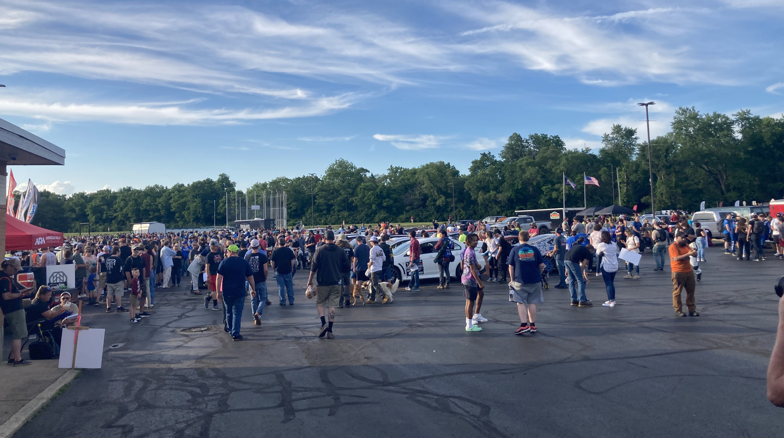
Commercialization Themes And Comparison to World Rally Championship (WRC)
Limited funds (mostly self-financed) and limited formal governance
Less emphasis on media coverage – individualized
Little room for incentivization
Grassroots – needs labor of 400+ volunteers to run events

Slide 9
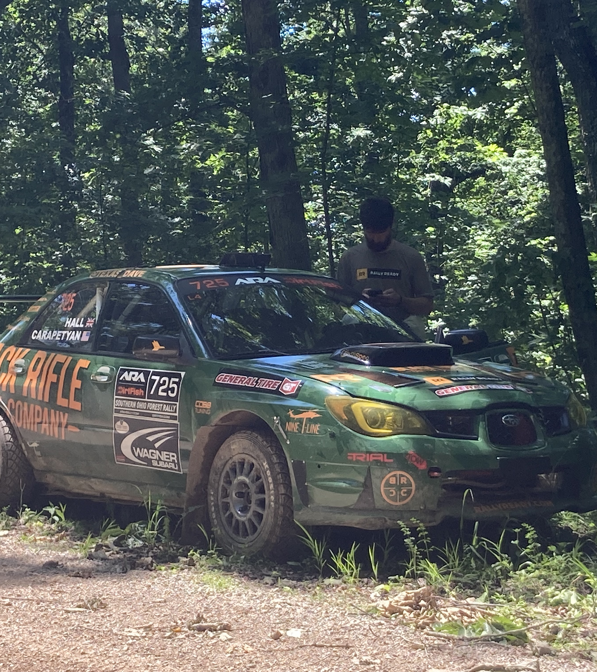
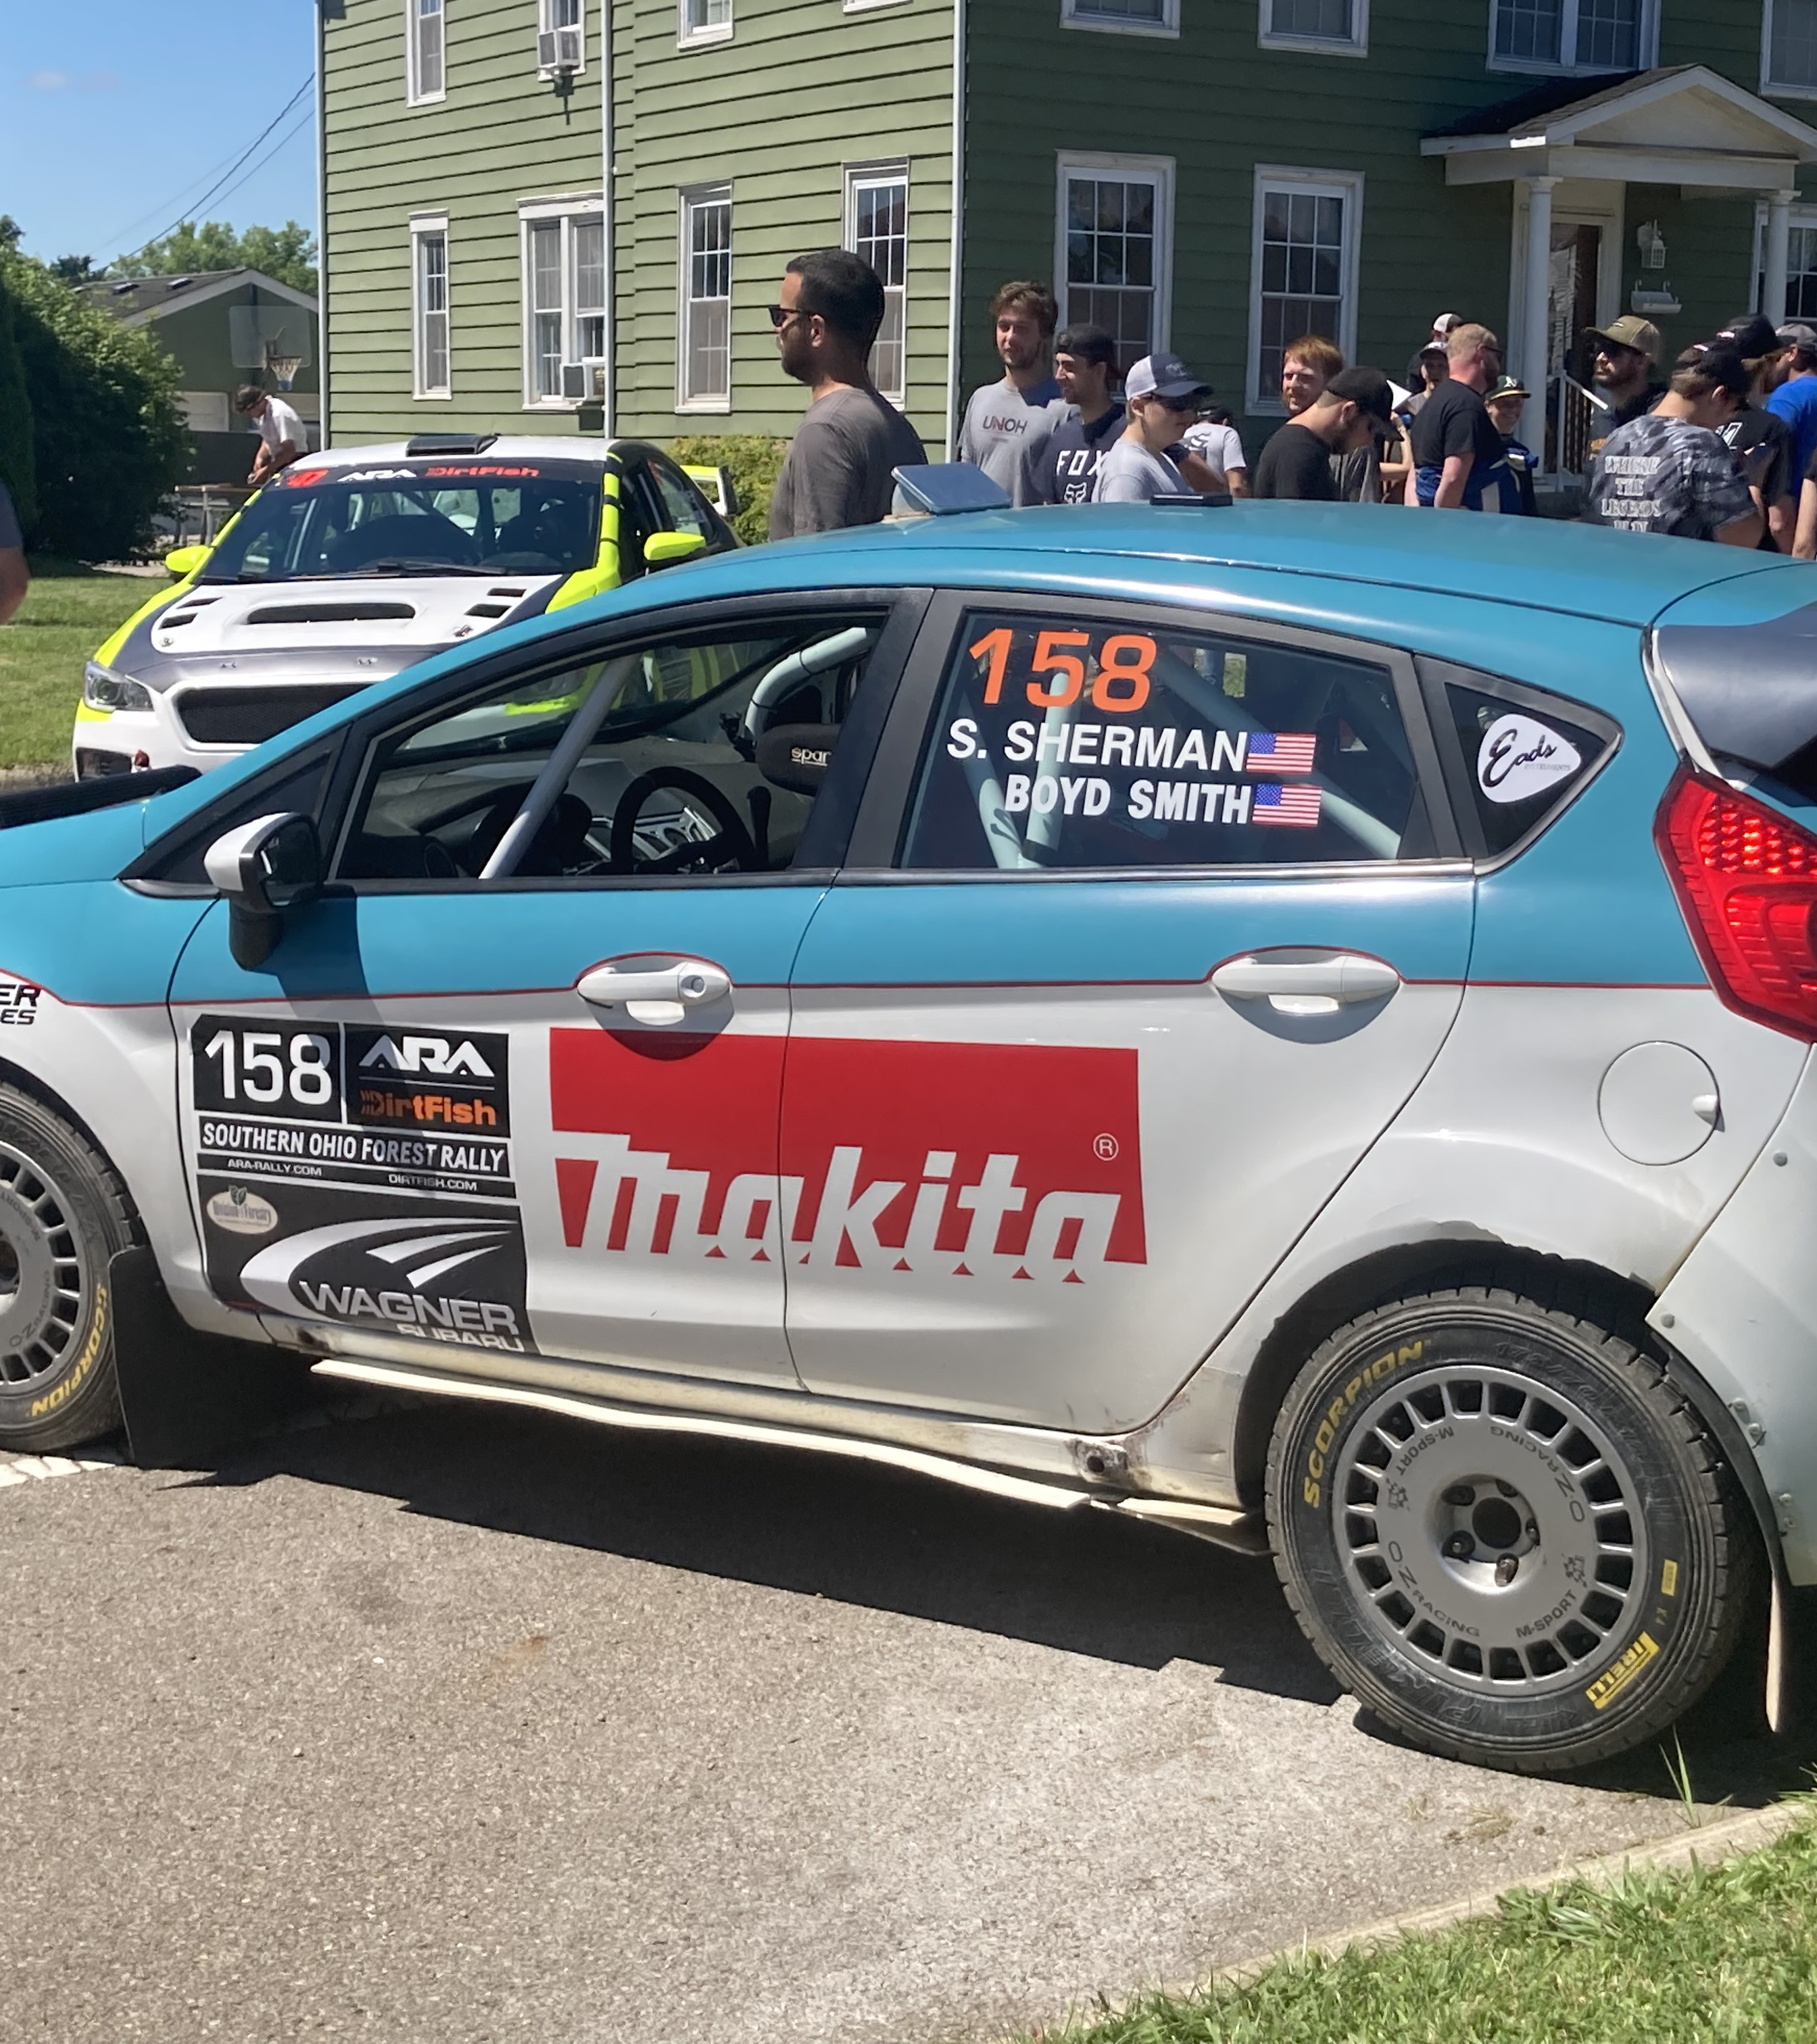
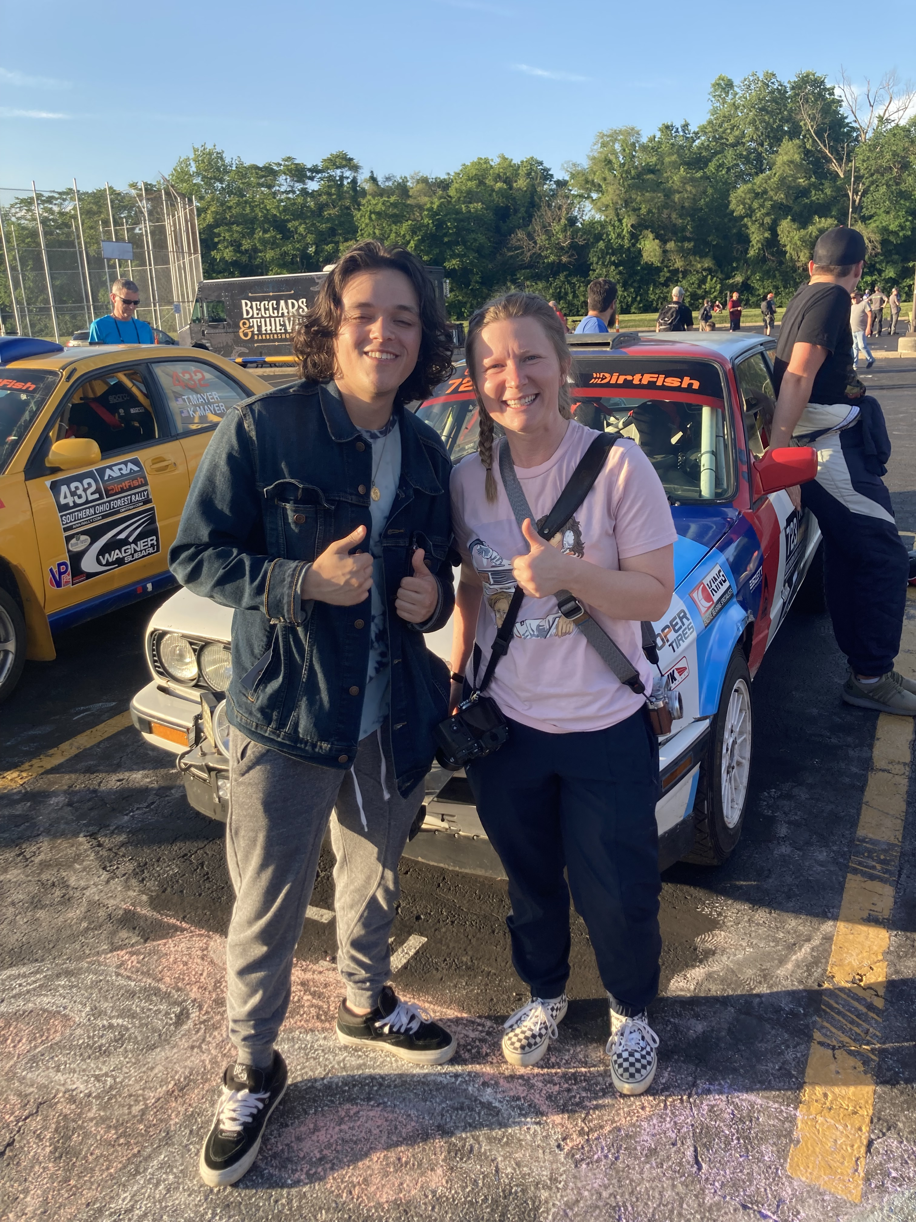
Sponsorships and Ad Opportunities

Slide 10
Future research plans
Continue to conduct interviews, transcribe, and analyze data collected this summer during AY 2022-2023
Reach out to key informants including professional drivers, co-drivers, and factory team staff
Volunteer at ARA National Rally East Event (STPR in Wellsboro, PA)
Data collected from from this summer will be analyzed for an Honors in the Discipline thesis

Slide 11
Thank You!
Acknowledgements – Thank you to the following:
My faculty mentor and Subaru Ambassador Dr. Michele Lee Kozimor
Members of the Rally Research Team: Dr. Barbara Prince, Emalie Rell, and Gavin Phillips for laying the groundwork for this project
Dr. Susan Mapp and the Elizabethtown College SCARP Program
Organizers of SOFR for allowing me to ride in the start and finish cars
All individuals who took time to be interviewed
A special thanks to Vilko Motorsports from Conestoga, PA, Kelsey Stephens, Meredith Pritchard, and Paul Jaeger
All the volunteers and participants at SOFR – without you stage rally events would not happen
For more information email: molinan@etown.edu
@RallyRaceBook

